Slide 1


ANTHROPIC · CLAUDE
Claude Code
in Practice
A hands-on guide to agentic coding in the terminal and IDE — the agent loop, project memory, plan mode, skills, and reviewing changes with confidence.
DEVELOPER TRAINING · 2026
Notes:
Welcome and framing. This is a hands-on session for developers who will use Claude Code daily. Goal: by the end, everyone can run Claude Code in their terminal or IDE, set up project memory, plan before acting, and review changes safely. Set expectations: we have live demos and a hands-on exercise, so have a terminal and a sample repo ready. One-line pitch to open with: 'Claude Code is an agentic coding tool — it reads your codebase, edits files, runs commands and tests, and hands back reviewable changes. You stay the reviewer and decision-maker.'

Slide 2
ROADMAP
What we'll cover today
Agentic, not autocomplete
Terminal & IDE
1
2
What Claude Code actually is and why it changes your workflow
The two surfaces where the agent runs
The agent loop
Memory & plan mode
3
4
Prompt → evaluate → run tools → repeat
CLAUDE.md context and thinking before doing
Skills & reviewing changes
Reviewable output + practice
5
6
Slash commands, skills, accepting diffs
Patterns, a live demo, and a hands-on exercise
Claude Code in Practice · Developer Training
2
Notes:
Walk the arc quickly — about 30 seconds. Emphasize this is sequential: each topic builds on the previous one. The first half is concepts and mechanics; the second half is the practical patterns, the live demo, and the exercise. Tell the audience the most important mindset to carry through every section: keep the human in the loop and keep changes small and reviewable.

Slide 3
CORE IDEA
Agentic, not autocomplete
Unlike a chatbot that answers and waits, Claude Code reads your files, runs commands, makes changes across files, and runs tests — working through a problem autonomously while you watch, redirect, or step away.
AUTOCOMPLETE
Suggests the next line. You drive every keystroke and stay inside one file.
The shift: you describe what you want, and Claude explores, plans, and implements — instead of you writing code and asking it to review.
AGENTIC
Takes a goal, plans multi-file changes, runs commands and tests, and delivers committed code for you to review.
Claude Code in Practice · Developer Training
3
Notes:
This is the conceptual unlock — spend time here. Many developers treat Claude Code like fancy autocomplete and get frustrated; the value comes from delegating whole tasks. Demo cue (optional, 1 min): in a terminal type a small task like 'add input validation to this function and a test for it' and let the class watch it read the file, edit, and run the test. Caution to state plainly: autonomy means it can run commands — that is why review and permissions (covered later) matter.

Slide 4

WHERE IT RUNS
Two surfaces: terminal & IDE
Terminal
1
The CLI agent on macOS, Linux, and Windows. Natural-language commands; it edits files and runs commands right where you work.
IDE & editor
2
Integrates into your editor so you review diffs inline and keep your normal workflow — plus desktop and browser surfaces.
Repo-aware
3
It reasons over the whole codebase, not just the open file — exploring, planning, and editing across many files.
Claude Code in Practice · Developer Training
4
Notes:
Make it concrete: ask who uses a terminal-first workflow vs. an IDE-first one — Claude Code meets both. Key point: it is the same agent regardless of surface, so skills, CLAUDE.md, and permissions carry across. Demo cue: show launching it in the terminal, then show the same project in the IDE with inline diffs. Note the supported platforms (macOS, Linux, Windows) in case anyone needs to install during the exercise.

Slide 5
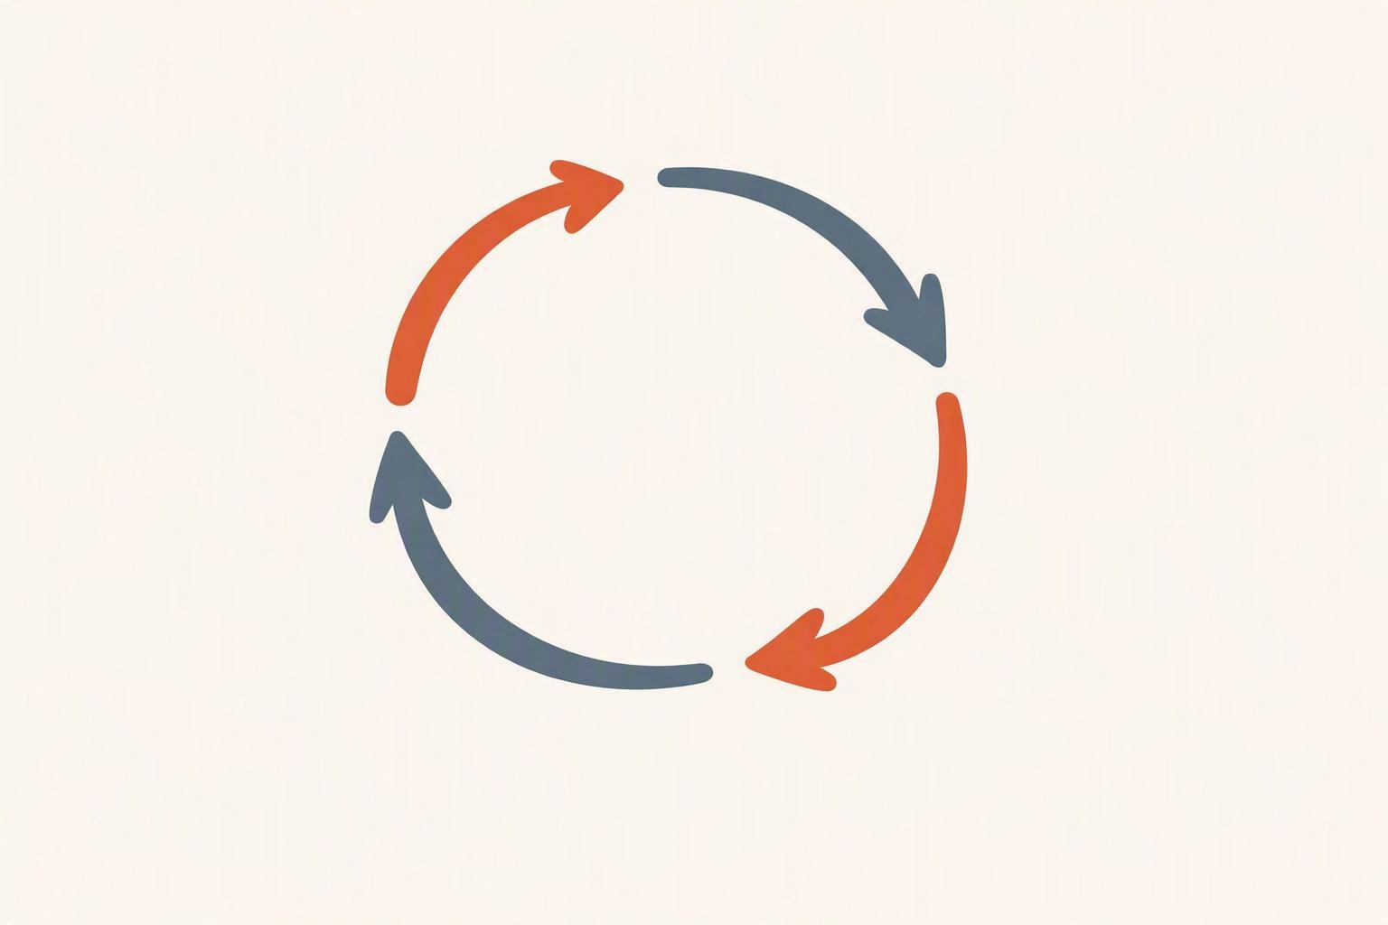
UNDER THE HOOD
The agent loop
1
Receive prompt
Your request joins the system prompt, tool definitions, and conversation history.
2
Evaluate & respond
Claude decides how to proceed — replying with text, requesting tool calls, or both.
3
Execute tools
It runs the tools (read, edit, run command), and the results feed back in.
4
Repeat the turn
Steps 2–3 cycle until the task is complete. Each full cycle is one turn.
Watch · redirect · step away — you stay in control of every turn.
Claude Code in Practice · Developer Training
5
Notes:
Explain why the loop matters for practice: every turn consumes context, and Claude's performance degrades as the context window fills — that is the root reason behind most best practices later (small tasks, fresh sessions, context minimalism). Emphasize that you can interrupt at any turn to redirect. Optional aside: the same loop powers the Agent SDK if anyone wants to build their own agents. Keep this tight — it's foundational but you don't need to go deep into internals.

Slide 6
PROJECT MEMORY
Give Claude lasting context with CLAUDE.md
Every session starts with a fresh context window. Two mechanisms carry knowledge across sessions — both load at the start of every conversation.
CLAUDE.md — you write it
Auto memory — Claude writes it
Persistent instructions and rules: coding standards, workflows, architecture.
Learnings and patterns it records from your corrections — build commands, debugging insights, preferences.
Scope it project, user, or org. Narrow rules by file type with .claude/rules/.
Per repository, shared across worktrees. Loads the first ~200 lines each session.
Tip: the more specific and concise your CLAUDE.md, the more consistently Claude follows it. To hard-block an action, use a PreToolUse hook — memory is context, not enforcement.
Claude Code in Practice · Developer Training
6
Notes:
This is the single highest-leverage habit — drive it home. A good CLAUDE.md is the difference between repeating yourself every session and having Claude 'just know' your project. Demo cue: open a CLAUDE.md and show 3–5 concise rules (build command, test command, style conventions, 'never touch X'). Stress conciseness: bloated files dilute the signal and waste context. Clarify the boundary: CLAUDE.md guides behavior but doesn't enforce it — for guarantees use hooks/permissions.

Slide 7
THINK BEFORE DOING
Plan mode
Before Claude edits files, runs commands, or changes state, it produces a plan and waits for your approval. You see what it intends to do, in what order, and why — then say yes, refine, or start over.
USE IT FOR
Unfamiliar codebases
Risky, multi-step or destructive work
Multi-file or multi-phase changes
HOW TO INVOKE
Press Shift + Tab twice — first press is Auto-Accept, second lands on Plan Mode.
SKIP IT FOR
Simple, read-only tasks
Small, contained edits
Work you already understand
Plan mode separates thinking from doing — no irreversible action before you both agree on "done."
Claude Code in Practice · Developer Training
7
Notes:
Frame the trade-off: plan mode is the cure for the most expensive mistake — letting the agent execute before you agree on scope. For risky work it's the difference between clean execution and a regrettable one; for trivial edits it's just friction. Demo cue: trigger plan mode (Shift+Tab twice) on a feature request, read the plan aloud, edit one step, then approve. Mention CLAUDE.md shapes the quality of the plan, so good memory + plan mode compound.

Slide 8
EXTENDING CLAUDE CODE
Slash commands & skills
In 2026 these are one unified system. Both turn repeatable work into a single invocation — the difference is how much they carry with them.
Slash commands
Skills
Reusable prompts you trigger by name — collapse repetitive typing into one word.
A SKILL.md plus supporting files. Adds what plain commands can't:
Automatic context loading
Supporting file directories
Frontmatter-controlled invocation
Run any skill with /skill-name
/commit
writes the message from your changes
/pr
drafts a full PR from your commits
Claude Code in Practice · Developer Training
8
Notes:
Position this as how teams scale good habits: encode your conventions once, everyone invokes them the same way. Slash commands are great for quick personal shortcuts; skills are how you package richer, shareable capability (with bundled files and auto-loaded context). Demo cue: run /commit or /pr live, then show a simple SKILL.md frontmatter. Encourage the team to start a shared skills/commands folder in the repo so the whole team benefits.

Slide 9
STAY IN CONTROL
Reviewing & accepting changes
Inspect every diff
1
Claude proposes changes as diffs. Read them before accepting — you approve or reject each edit and command.
Permission prompts
2
Sensitive actions (running commands, writing files) ask first. Auto-accept mode trades prompts for speed — use it deliberately.
Automated PR review
3
Code Review runs a fleet of agents over a pull request and posts findings as inline comments on the exact lines.
Claude Code in Practice · Developer Training
9
Notes:
This is the safety backbone of the whole talk — never let the audience skip review. The agent's autonomy is only safe because you gate the output. Practical guidance: keep auto-accept for low-risk, well-scoped loops and turn it off for anything touching production paths, migrations, or unfamiliar code. Demo cue: show accepting one hunk and rejecting another, and trigger a permission prompt. Mention Code Review (research preview, Team/Enterprise) as the CI-side complement to local review.

Slide 10
PRACTICAL PATTERNS
Keeping output reviewable
Small, scoped tasks
Plan, then execute
One change per loop. Small diffs are easy to read, test, and roll back.
Approve a plan first so review starts before any file changes.
Verify continuously
Context minimalism
Ask for tests and have Claude run them — verification beats trust.
Start fresh sessions for new tasks; a full context window degrades quality.
Commit in steps
Encode the rules
Frequent, focused commits create natural review checkpoints.
Put review standards in CLAUDE.md and skills so they apply every time.
Claude Code in Practice · Developer Training
10
Notes:
Tie these back to the agent loop: each pattern fights context bloat or keeps diffs small — the two things that make AI output trustworthy. The Claude Code team frames the breakthrough as 'verification, routines, and context minimalism.' Encourage one routine to adopt this week: plan mode + small task + run tests + review diff + commit. Ask the room which pattern they'll commit to — makes it stick.

Slide 11
PUTTING IT TOGETHER
Live demo · build a feature end-to-end
Example task: “Add a dark-mode toggle to settings — remember the choice and follow the system default until the user picks one.”
1
Open the repo
2
Set memory
3
Plan mode
Launch Claude Code in the terminal or IDE on a real project.
Confirm CLAUDE.md has build, test, and style rules.
Shift+Tab twice; review and refine the proposed plan.
4
Run the loop
5
Review the diff
6
Commit
Let it edit across files and run the tests.
Accept good hunks, reject or redirect the rest.
Use /commit, then /pr to open a reviewable pull request.
Claude Code in Practice · Developer Training
11
Notes:
Run-of-show for the demo (~8–10 min). Narrate your thinking at each step so the audience sees the judgment, not just the keystrokes. Pause at plan mode to edit a step live — shows you steering. At the diff, deliberately reject one change and ask Claude to redo it differently. If anything goes sideways, that's a teaching moment about interrupting the loop and tightening the prompt. End by opening the PR so it connects to their real workflow. Have a backup recording in case of network issues.

Slide 12
YOUR TURN
Hands-on exercise · 20 minutes
DO THIS
DONE WHEN
Open a sample repo in Claude Code (terminal or IDE).
Add a short CLAUDE.md with build, test, and style rules.
Use plan mode to add a small feature; refine the plan.
Run the loop, then review and accept the diff.
Finish with a slash command — /commit, then /pr.
A plan approved before any edit
You rejected at least one hunk
Tests ran and passed
A PR is open and reviewable
Claude Code in Practice · Developer Training
12
Notes:
Logistics: pair developers who are new with those who've installed it already. Circulate while they work. Common stumbling blocks to pre-empt: forgetting to enter plan mode (remind: Shift+Tab twice), vague prompts (push them to be specific), and accepting diffs without reading. The 'reject one hunk' criterion is deliberate — it forces real review. Keep a sample repo and a known-good CLAUDE.md ready to hand out. Reconvene with a 2-minute debrief: what surprised you?

Slide 13
AVOID THE TRAPS
Pitfalls & best practices
DO
DON'T
Keep tasks small and scoped
Plan before risky or multi-file work
Read every diff before accepting
Keep CLAUDE.md specific and concise
Start fresh sessions for new tasks
Treat it like blind autocomplete
Auto-accept changes you didn't read
Let one session run forever
Rely on memory for hard guarantees
Skip tests because it “looks right”
Claude Code in Practice · Developer Training
13
Notes:
Most best practices trace to one constraint: the context window fills fast and quality degrades as it fills — so small tasks and fresh sessions aren't style preferences, they're performance. Reinforce the 'memory is context, not enforcement' point: for must-not-happen actions, use PreToolUse hooks or permission rules, not a line in CLAUDE.md. Invite war stories from anyone who's already hit these traps — peer examples land harder than slides.

Slide 14
SUMMARY
The five things to remember
1
Agentic, not autocomplete Delegate whole tasks across the terminal and IDE.
TRAINER'S NOTE
2
Close by looping back to the live demo: every feature on this slide showed up in that one workflow. Ask each person to name one habit they'll adopt this week — plan mode, a CLAUDE.md rule, or reading every diff. Point them to the docs and your team's shared skills folder, and offer office hours for follow-up.
Memory drives quality A concise CLAUDE.md gives every session lasting context.
3
Plan before doing Approve a plan first on risky, multi-step work.
4
Extend with skills Slash commands and skills encode your team's routines.
5
You own the review Small diffs, run tests, accept deliberately.
Claude Code in Practice · Developer Training · 2026
Notes:
Trainer's summary and run-of-show recap. Spend the final 3–4 minutes here. Reinforce the through-line: Claude Code is an agentic tool across the terminal and IDE; it works in a loop (prompt → evaluate → run tools → repeat); CLAUDE.md and auto memory carry context across sessions; plan mode separates thinking from doing; slash commands and skills package repeatable work; and you stay the reviewer who accepts or rejects every change. The one sentence to leave them with: keep tasks small, keep changes reviewable, and keep yourself in the loop. Action items to assign: install Claude Code if they haven't, add a CLAUDE.md to one real repo, and run the plan-mode-to-PR workflow once before next session. Share links to the official Claude Code docs and the team's shared commands/skills, and book optional office hours for blockers.

